Slide 1

Cross Sectional Momentum Trading
Arash Barmas
Financial Mathematics, UCLA

Slide 2
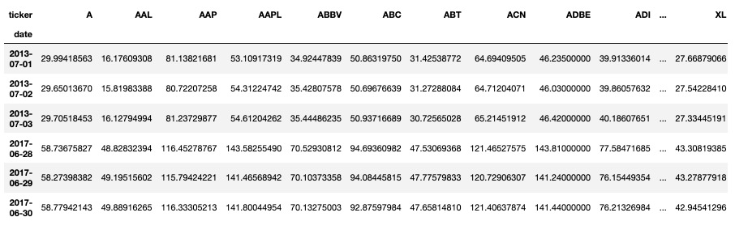
Data
Used S&P 500 end of day data from 2013-07-01 till 2017-06-30.

Slide 3
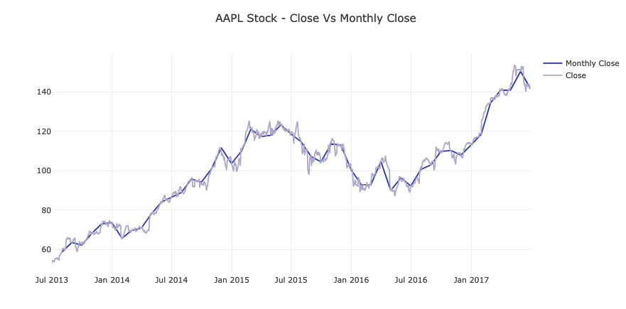
Resample Prices
Our trading strategy is based on month-end prices.
The trading is performed once a month, so we resampled month end prices.
For AI or ML strategies, it might be useful to try CUSUM test for resampling.

Slide 4
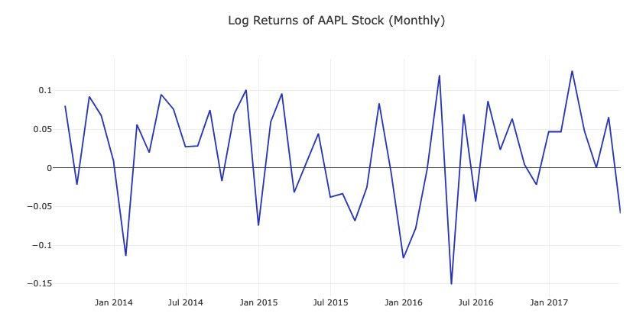

Log Return
We use monthly log return as a primary source of indicator for momentum signal
$$R_{t}= log_{e}\left( P_{t} \right) - log_{e}( { P}_{t−1} )$$

Slide 5
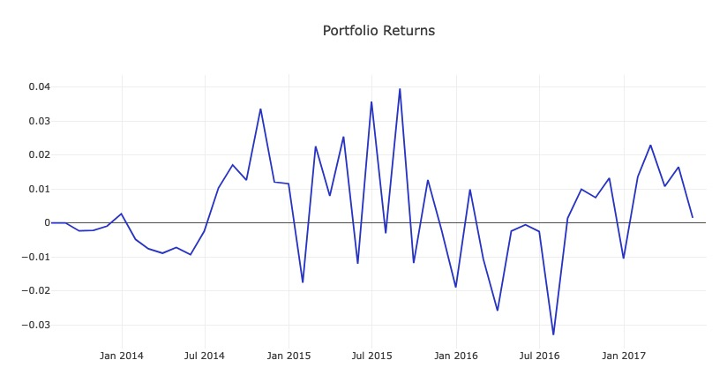
Trading Strategy
At the end of each month, we sort stocks based on their performance on last month. We go long on 50 top performers and short on 50 bottom performing stocks and create equally weighted portfolio.

Slide 6
Parameters of the model
Number of stocks to go long and short: 50(long) and 50(short)
Look back period to decide top and bottom performers: 1 month
Universe: S&P 500

Slide 7

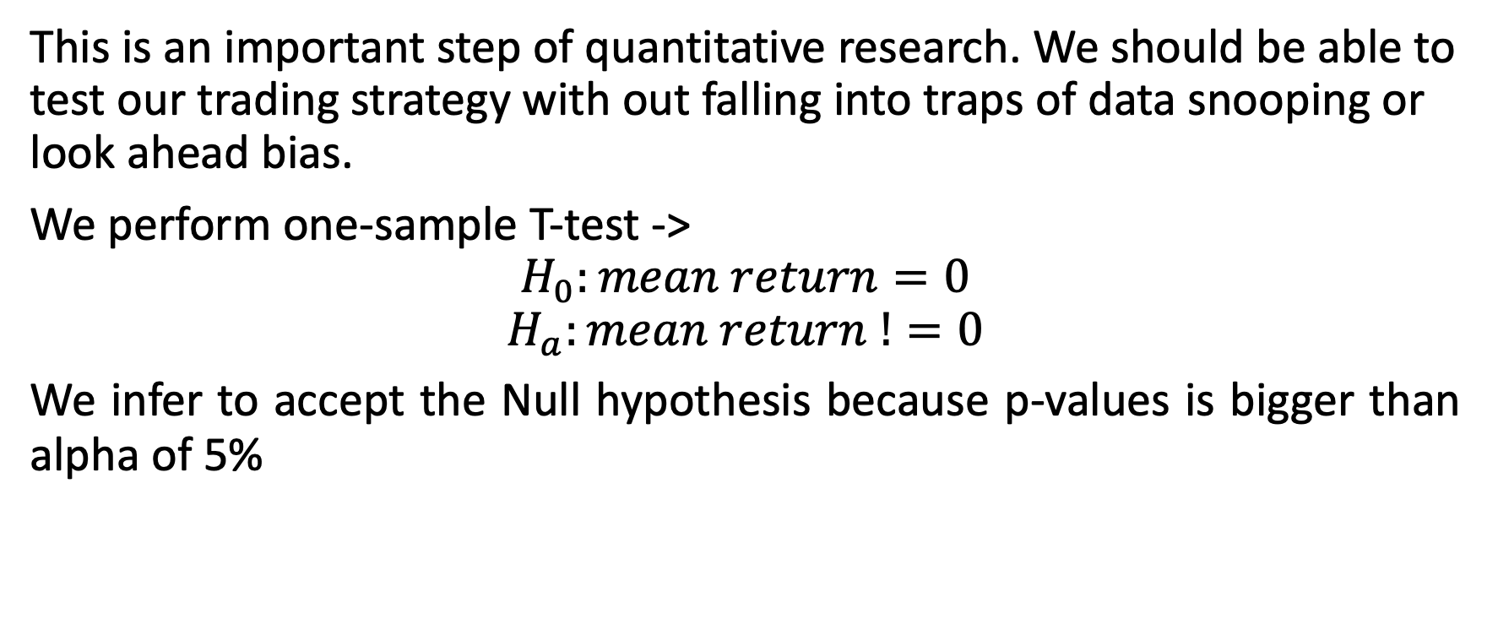
Statistical Analysis
This is an important step of quantitative research. We should be able to test our trading strategy with out falling into traps of data snooping or look ahead bias.
We perform one-sample T-test ->
$$H_{0}:mean return=0$$
$$H_{a}:mean return !=0$$
We infer to accept the Null hypothesis because p-values is bigger than alpha of 5%

